Slide 1
V10 Configuration
Business Rules - Activities

Slide 2
Assessment Creation process
Objective
At the end of this session you will be able to :
Explain the role of business activity rules in ClaimCenter
Write business activity rules to create activities, set fields, and add history records

Slide 3
Business Rules - Activities

Slide 4
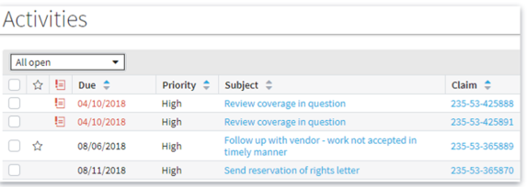
Activities Review
An activity is a task or unit of work involved in handling a claim (a to do list)
In ClaimCenter, activities are used to track the completion of tasks
Activities are created and assigned to groups and uses to complete
Notes:
Activities are essentially items in a “to do” list. The list tells users what they need to accomplish and by when. Activities can have a due date and a time period. If the activity is not completed by the escalation date, the activity is escalated ( an indicator is set to call attention to it) to make sure it is finished in a timely mannner

Slide 5
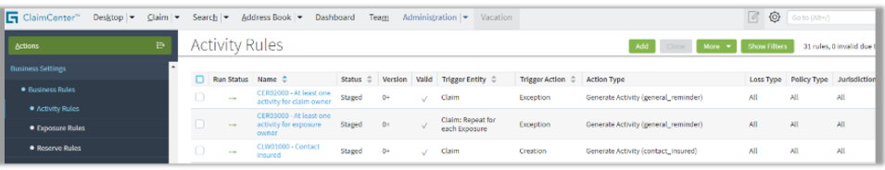
Business Activity Rules
Business activity rules are used to automatically create activities
Business activity rule definitions control when and what activities are created
Creating the rules requires only limited knowledge of the Guidewire data model
Notes:
Automating the creation of activities is a big part of the way ClaimCenter gets things done. By creating activities according to business activity rules. ClaimCenter takes on a significant amount of the administrative trivia that managers must deal with and frees them up to do more productive work. Similarly, line workers are never in doubt about their tasks and priorities. Business Activity Rules can be created by an Administrator. The rules are triggered by changes in an entity. So some knowledge of the ClaimCenter data model is required, but only a limited knowledge.

Slide 6
Business Activity Rules
Can automatically create activities and history records
Can also change the value of fields on an object (claim or exposure)
Enable quick response to changing business needs without coding
Are managed in the ClaimCenter admiration UI
Can be deployed immediately, without server downtime
Notes:
The business activity rules editor allows an administrative user to create rules that, on some condition, create an activity. It can also create history records or even change the value of some fields. This provides a mechanism that business analysts can use to respond to changing needs without needing to either write program code or have it written and implemented. The rules are managed from the ClaimCenter administrative user interface. The rules can be deployed immediately without any server downtime.

Slide 7
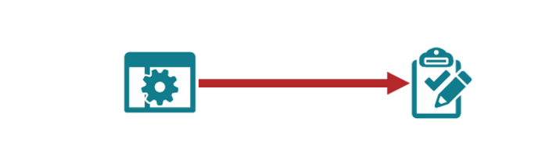
Business Activity Rules
Can automatically create activities and history records
Can also change the value of fields on an object ( claim or exposure)
Enable quick responses to changing business needs without coding
Are managed in the ClaimCenter administration UI
Can be deployed immediately, without server downtime.
Notes:
The business activity rules editor allows an administrative user to create rules that, on some condition, create an activity. It can also create history records or even change the value of some fields. This provides a mechanism that business analysts can use to respond to changing needs without needing to either write program code or have it written and implemented. The rules are managed from the ClaimCenter administrative user interface. The rules can be deployed immediately without any server downtime

Slide 8
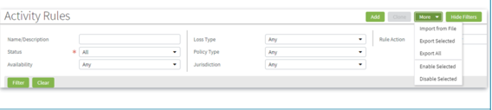
Business Activity Rule User Interface
Navigate to Administration → Business Settings → Business Rules → Activity Rules
Can filter to show specific rules
Can add, clone, export and import rules
Filters for a specific jurisdiction return jurisdiction where the value is All in addition to the jurisdiction
Notes:
The business activity rules user interface is in the Administration screens under Business Settings and Business Rules. You can select Show Filters to use filtering to help focus on a specific set of rules. You can add rules from this page or if you select a rule, or rules, you can clone those rules. You can also clicking rule name to open the Rules screen to see the details or even edit the rule
Note that business rule cannot be deleted, only disabled
Filtering by Loss Type, Policy Type and Jurisdiction returns all rules that meet that criteria. However, remember that if a rule applies to All Loss Types. Then that rule will be returned as well. That is because that rule will apply to the specific Loss Type and since a Loss Type is All on the rule then that rule meets the filter criteria
For example, if you filter for a policy type of Businessowners, the results will include rules where the policy type value is set to all “ALL” That’s because those rules apply to the selected case since it is part of all

Slide 9
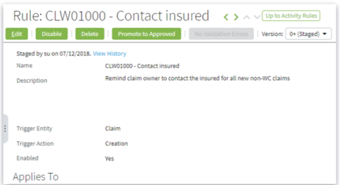
Rule Definition : Basics
Every rule must have a:
Name
Description
Trigger entity
The entity for which a rule executes
Options include claim, exposure, checkset, recoveryset, reserveset and recoveryreserveset
Trigger action
The event which causes the rule to fire
Options include creation, update and exception
Action is tied to the trigger entity
Enabled status
Notes:
Business rules have several parts. Rules are defined by a name, description and the triggering entity.
The purpose of the triggering entity is to establish which entity will cause the business rule to be executed. For example, if the triggering entity is exposure. The rule will only be executed when something happens on the exposure entity.
The Trigger action determines what type of action the rule is looking for on the entity. The options are creation, update and exception. For example, if the rule has a trigger action of creation on the exposure entity. It will only be executed when a exposure is created. However, if it is set to update then the rule will be executed when the exposure is updated which includes when it is created.
You can also set the enabled status to yes or no. If the status is set to no, then it will not be executed.

Slide 10
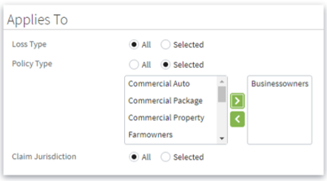
Rule Definition : Applies To
Rules can apply to All types or to Selected types
Click the Selected radio button to see and select values
Selecting a value limits what the rule is applied to
Can apply any combination of:
Loss type
Policy type
Jurisdiction
Notes:
As we just saw, the execution of a rule may be restricted by the entity and type of action on that entity. You can further restrict the conditions on which the rule applies by specifying Loss types, Policy types, and Claim jurisdiction. Setting those values restricts or limits the application of the rule.
Note that it is possible to select a loss type and a policy type which are mutually exclusive. For example, you can select Loss Type = Travel and Policy Type = Worker’s Compensation. If you do this, the rule will never fire.

Slide 11

Rule Definition : Rule Variables
Variables that make reading rule conditions simpler
Can be based on any data accessible from the rule’s trigger entity

Slide 12
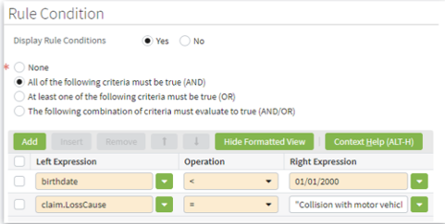
Rule Definition: Rule Condition
Criteria ( one or more ) which determine when a rule applies
None selected means the rule actions are run for all candidates meeting the trigger and Applies to requirements
Criteria can be joined by AND, OR, or some combination
Conditions have access to data in the triggering entity
Use type-down to select attributes
Notes:
To further limit the application of a rule. You can specify Rule conditions. If the Rule condition is set to None. The rule is not restricted further than you have already specified with the entity., trigger action and applies to values.
You can specify multiple conditions to be checked before the rule will execute. You can set that all the conditions must be true by using the And condition. You can use the Or condition to execute the rule if any of the conditions are true. You can also use a combination of both
You can access entity specific data in the rule conditions by entering the entity name and using dot notation for data on the entity

Slide 13
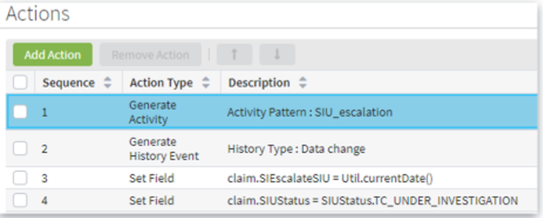
Rule Definition : Actions
Actions define what is done to candidates that pass the conditions test
Consist of one or more changes the rule can make
Can include one or more of:
Generate an activity
Set a field value
Generate a history record
Notes:
Actions are the “what to do” part of the business rules. When a candidate triggers the rule and passes all the restrictions, then the action is executed.
A rule may execute one or more actions. The available action types are Generate Activity, Generate History Event, and set Field. A rule may contain multiple instances of any of the action types and any combination of action types.

Slide 14
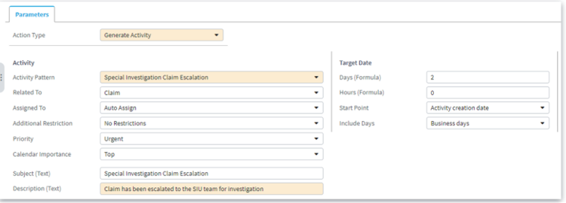
Action – Add Activity
Rule creator must specify the Activity Pattern
Other attributes are taken from the Activity Pattern
Can be overridden by rule creator
Notes:
For the Generate Activity action type, the activity pattern is required. When you add a Generate Activity action type, you must set the activity pattern. You may then change the inherited parameters as necessary.
You can change how the activity should be assigned whether the activity can be duplicated on a claim the subject and the description of the activity, and so on.

Slide 15
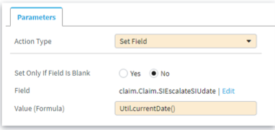
Action – Set a Field value
Rule creator must specify:
The field to set
The value to set
Whether to set a new value for a field that already has a value ( “Set Only if Field is Blank”)
Notes:
The Set Field activity is useful if you need to change or set a value on the entity based on some condition. For example, you can set the Special Investigation Escalation update date to the current date when this rule is executed. As with the creation of conditions, when you edit Field and Value, type ahead helps locate the field you need and avoid typographic errors.

Slide 16
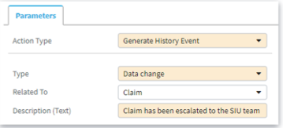
Action – Add a History Record
History records timestamp significant actions
Rule creator must specify:
The type of history event
A description of this history event
Related To, which is only Claim
History types include:
Activity due date change
Approval or rejection
Policy edited
Reserve created
And so on
Notes:
In addition to generating activities and setting field values. You can create history records using the business activity rules. This is useful to add a timestamp to events that happen such as creating an activity for the Special Investigations Unit. Each history event is required to have a type ( this is the type of event that caused the history record to be created ) what entity it is related to and a description of the event. Some examples of event types are Activity due date changes. Approval or rejection, Policy edited, Reserve created and so on.

Slide 17
Creating Activities with business activity rules

Slide 18
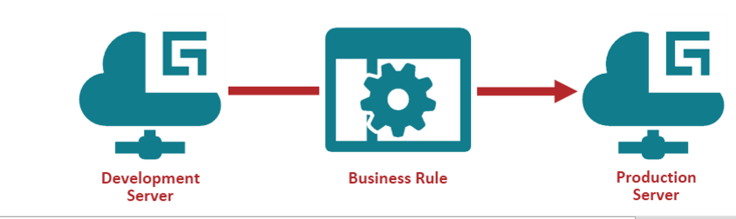
Migrating business activity rules
Create and test in a development environment, then migrate to the production environment.
Business activity rules can be created in the production environment
Useful for urgent situations like catastrophe management
Notes:
Business activity rules should be created and tested in a development environment the rules can be tested and modified as necessary to get the expected results. This is the suggested method of creating business activity rules. In extreme circumstances you can create rules on the fly in production. However, you will generally want to use a development server for rule creation and testing. When the rules are tested and approved. You can migrate them to the production environment.

Slide 19

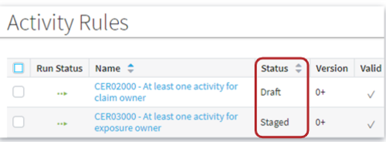
Business activity rule life cycle
On Development server:
Draft – Business rule has been created but not yet be complete or tested.
Staged – Business rule has been tested and is ready for deployment
On Production server:
Approved – Business rule is ready for deployment
Deployed – rule is executing
Notes:
On the development server, the initial status of a rule is Draft. After the rule is tested and approved. You set the status to staged by clicking the Promote to Staged button on the Edit rule page.
Once a rule is in Staged status if can be exported from the development server so that it can be imported into the production server. When the rule is imported into the production server, it comes in a Staged. When the status is changed to Approved. The rule will be evaluated at runtime.

Slide 20
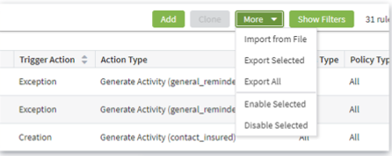
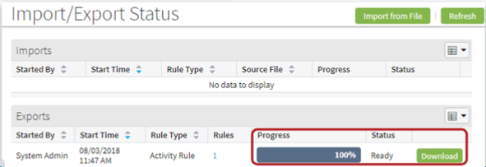
Exporting, downloading, and importing rules
On the Activity Rules page, you export and import rules
On the Import/Export status page, you download the rules for import in another environment
Notes:
On both development and production servers, you import and export rules from the Activity Rules page. On the development server, you can only export rules that have a status of Staged. Once the export is complete, indicated by the Progress showing at 100%. You can download the file.
You can then import that file into either the development or production server depending on which direction you are going.

Slide 21
Review Question
What two types of objects can business activity rules create?
Activities and history records

Slide 22
Review Question
What two restrictions are mandatory on a business activity rule?
Trigger entity ( restricts the business rule to respond to a specify entity)
Trigger action ( restricts the business rule to respond to creation, or update action)

Slide 23
Review Question
What does setting the Rule Condition to None accomplish?
Setting the Rule Condition to None means that all entities which meet the Trigger Entity, the Trigger Action, and any Applies To values will be processed by this rule

Slide 24
Thank you

